Slide 1
Report 1
109030605
黃昭學

Slide 2

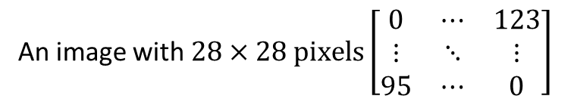
Data preprocessing
An image with $28×28 pixels\left[\begin{matrix}0 & ⋯ & 123 \\ ⋮ & ⋱ & ⋮ \\ 95 & ⋯ & 0\end{matrix}\right]$
Data-preprocessing enable each data (image) presenting in same range (0~1), which could optimize the gradient descent.
The maximum value of image pixels is 255
Normalization (min-max scaler)
An image with $28×28 pixels\left[\begin{matrix}0 & ⋯ & 0.4823 \\ ⋮ & ⋱ & ⋮ \\ 0.3725 & ⋯ & 0\end{matrix}\right]$

Slide 3
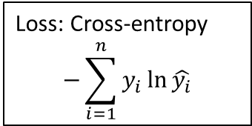
Q1: Model architecture—Dense neural layer
100 neurons
0.00
Loss: Cross-entropy
$$−\sum_{i=1}^{n}{y_{i}\ln{\hat{y_{i}}}}$$
50 neurons
0.12
20 neurons
10 neurons
10 labels
0.56
……
……
784
pixels
Dense
……
Dense
……
Dense
Dense
……
……
0.23
0.63
Y : Ground-truth
0.46
0.00
Hidden layer 3
ReLU
Output layer
softmax
Hidden layer 1
ReLU
Hidden layer 2
ReLU

Slide 4
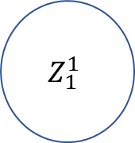
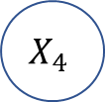
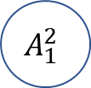

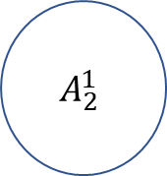


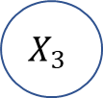
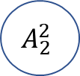

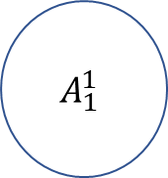



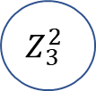



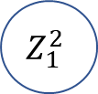



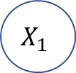



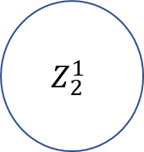


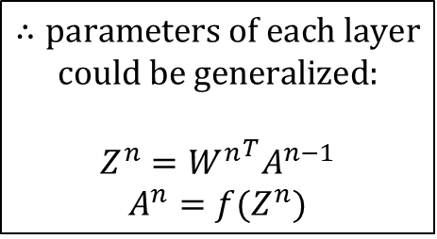

Q2: Feed forward
$$b_{1}^{2}$$
$$b_{1}^{1}$$
$$f(Z^{2})$$
$$X_{1}$$
$$Z_{1}^{2}$$
$$A_{1}^{2}$$
$$W^{1}$$
$$W^{2}$$
$$∴parameters of each layer$$
$$could be generalized:$$
$$Z^{n}={W^{n}}^{T}A^{n−1}$$
$$A^{n}=f(Z^{n})$$
$$Z_{1}^{1}$$
$$f(Z^{1})$$
$$A_{1}^{1}$$
$$b_{2}^{2}$$
$$X_{2}$$
$$Z_{2}^{2}$$
$$f(Z^{2})$$
$$A_{2}^{2}$$
$$b_{2}^{1}$$
………….
$$X_{3}$$
$$Z_{2}^{1}$$
$$f(Z^{1})$$
$$A_{2}^{1}$$
$$b_{3}^{2}$$
$$Z_{3}^{2}$$
$$f(Z^{2})$$
$$A_{3}^{2}$$
$$X_{4}$$
$$Z^{1}={W^{1}}^{T}X+b^{1}$$
$$Z^{2}={W^{2}}^{T}A^{1}+b^{2}$$
$$A^{1}=f(Z^{1})$$
$$A^{2}=f(Z^{2})$$

Slide 5

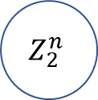
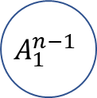
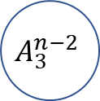

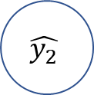


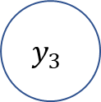
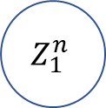




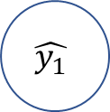
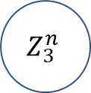








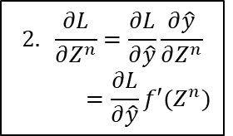
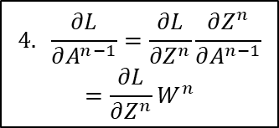
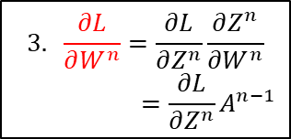


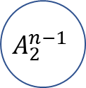
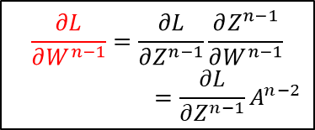




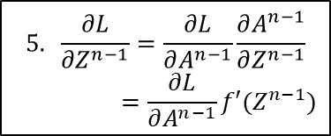


Q2: Back propagation
Loss: Cross-entropy
$$−\sum_{i=1}^{n}{y_{i}\ln{\hat{y_{i}}}}$$
Target: solve $\frac{∂L}{∂W},\frac{∂L}{∂b}$
$${L_{1}=−y}_{1}\ln{\hat{y_{1}}}$$
$$b_{1}^{n}$$
$$y_{1}$$
$$\hat{y_{1}}$$
$$\hat{y}=f(Z^{n})$$
$$Z_{1}^{n}$$
$$b_{1}^{n−1}$$
$$A_{1}^{n−2}$$
$$b_{2}^{n}$$
$$A_{1}^{n−1}$$
$$A^{n−1}=f(Z^{n−1})$$
$$Z_{1}^{n−1}$$
$${L_{2}=−y}_{2}\ln{\hat{y_{2}}}$$
$$y_{2}$$
$$\hat{y_{2}}$$
$$Z_{2}^{n}$$
$$A_{2}^{n−2}$$
……
$$W^{n}$$
$$b_{2}^{n−1}$$
$$W^{n−1}$$
$$b_{3}^{n}$$
$$A_{2}^{n−1}$$
$$Z_{2}^{n−1}$$
$$\frac{∂L}{∂W^{n−1}}=\frac{∂L}{∂Z^{n−1}}\frac{∂Z^{n−1}}{∂W^{n−1}}$$
$$=\frac{∂L}{∂Z^{n−1}}A^{n−2}$$
$${L_{3}=−y}_{3}\ln{\hat{y_{3}}}$$
$$y_{3}$$
$$\hat{y_{3}}$$
$$Z_{3}^{n}$$
$$A_{3}^{n−2}$$
$$2. \frac{∂L}{∂Z^{n}}=\frac{∂L}{∂\hat{y}}\frac{∂\hat{y}}{∂Z^{n}}$$
$$=\frac{∂L}{∂\hat{y}}f′(Z^{n})$$
$$3. \frac{∂L}{∂W^{n}}=\frac{∂L}{∂Z^{n}}\frac{∂Z^{n}}{∂W^{n}}$$
$$=\frac{∂L}{∂Z^{n}}A^{n−1}$$
$$4. \frac{∂L}{∂A^{n−1}}=\frac{∂L}{∂Z^{n}}\frac{∂Z^{n}}{∂A^{n−1}}$$
$$=\frac{∂L}{∂Z^{n}}W^{n}$$
$$5. \frac{∂L}{∂Z^{n−1}}=\frac{∂L}{∂A^{n−1}}\frac{∂A^{n−1}}{∂Z^{n−1}}$$
$$=\frac{∂L}{∂A^{n−1}}f′(Z^{n−1})$$
$$1. \frac{∂L}{∂\hat{y}}=\frac{−y}{\hat{y}}$$
$$3. \frac{∂L}{∂b^{n}}=\frac{∂L}{∂Z^{n}}\frac{∂Z^{n}}{∂b^{n}}=\frac{∂L}{∂Z^{n}}$$
$$\frac{∂L}{∂b^{n−1}}=\frac{∂L}{∂Z^{n−1}}\frac{∂Z^{n−1}}{∂b^{n−1}}=\frac{∂L}{∂Z^{n−1}}$$

Slide 6
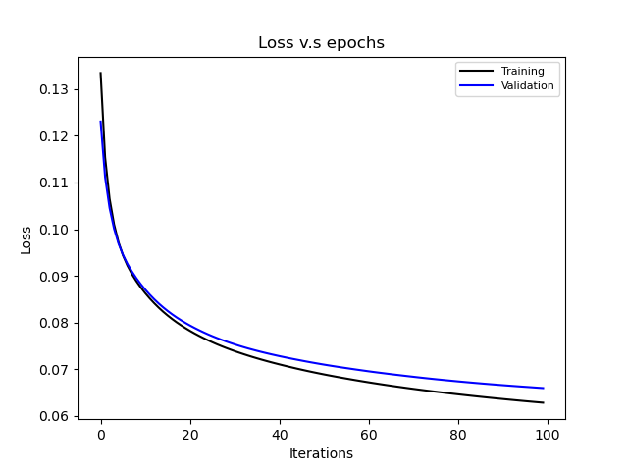
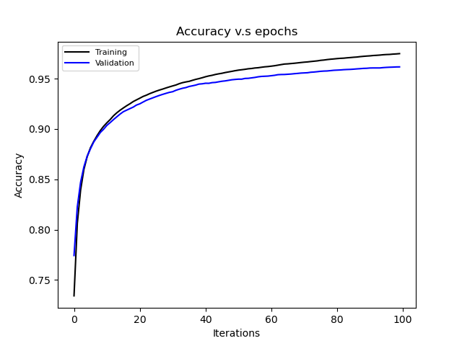
Q3: Training Loss & Validation Loss
Loss after 100 epochs reduce to 0.065
Accuracy after 100 epochs reach 0.9617

Slide 7
Q4: If we use a very deep NN with a large number of neurons, will the accuracy increase?
No.
While deeper network and larger number of neurons could relatively increase the accuracy of prediction. But once the optimization is saturated, the deep structure may overfit the training data, and the testing accuracy would drop.

Slide 8
Q5: Why do we need to validate our model?
Validation data is used to estimate the model whether it is overfitted or not while model itself is still tuning the hyper-parameters. In other words, validation datasets give bias to the training model to avoid an unbiased evaluation in training data.

Slide 9
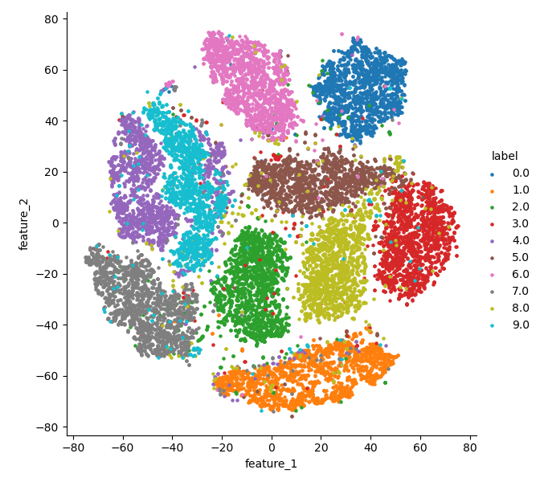
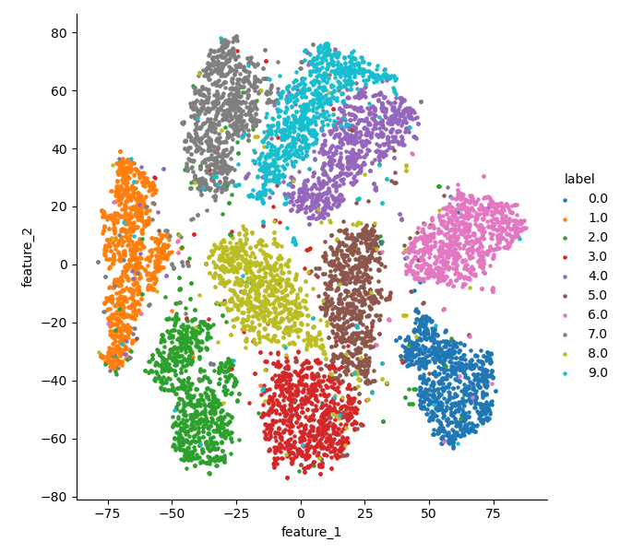
t-distributed stochastic neighbor embedding (T-SNE)
Labels of Validation data
Labels of testing data

